Slide 1
Test Automation CS 4501 / 6501 Software Testing

Slide 2

Software Testing Activities
review
Test
Manager
Test
Engineer
automate
1. Test
Design
2. Test
Automation
3. Test
Execution
design
instantiate
Test
Engineer
Computer
P
analyze
execute
Test
Engineer
4. Test
Evaluation
Output

Slide 3
Software Testing
Design tests
Revenue task
Enter inputs, run program, record results
Excise task
Enter
Test values
(inputs)
Actual results
Expected results
Program
vs
Comparison
Execute tests against the program under test
Analyze results
Revenue task

Slide 4
What is Test Automation
The use of software to control the execution of tests, the comparison of actual outcomes to predicted outputs, the setting up of test preconditions, and other test control and test reporting functions
Test values
(inputs)
Program
Actual results
vs
Expected results
Executable Tests
Precondition
Test control
Test inputs
Expected results
Comparison
Report

Slide 5
Benefits of Test Automation
Reduce excise tasks
Free up time to focus on revenue tasks (such as test design)
Allow the same test to be run thousands of times without extra effort
Reduce cost
Reduces human error
Reduce variance in test quality from different individuals
Significantly reduce the cost of regression testing
Automate as much as possible

Slide 6
What Makes Test Automation Hard
Testability
The degree to which a system or component facilitates that establishment of test criteria and the performance of tests to determine whether those criteria have been met
Two practical problems:
How to provide the test values to the software
How to observe the results of test execution
How hard it is to find faults in the software

Slide 7
Observability
How easy it is to observe the behavior of a program in terms of its outputs, effects on the environment and other hardware and software components
Example of software that often have low observability:
Embedded software often does not produce output for human consumption
Component-based software
Distributed software
Web applications
Mobile applications

Slide 8
Controllability
How easy it is to provide a program with the needed inputs, in terms of values, operations, and behaviors
Example of software that often have low controllability:
Embedded software often gets its inputs from hardware sensors – difficult to control and some inputs may be difficult, dangerous, or impossible to supply
Component-based software
Distributed software
Web applications
Mobile applications

Slide 9
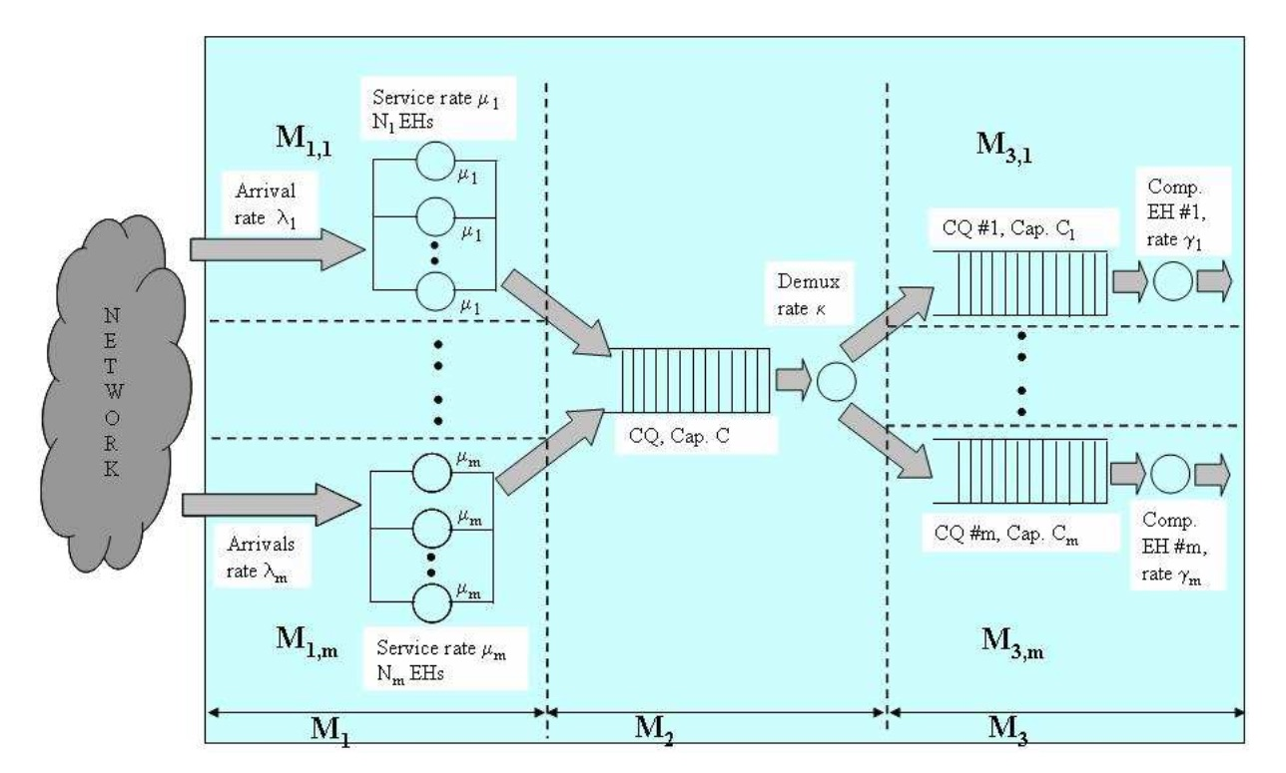
Dealing with Observability and Controllability
Simulation – bypass the hardware or software components that interfere with testing

Slide 10
Importance of Testability
Testability is crucial to test automation
Test scripts need to control the execution of the component under test
Test scripts need to observe the results of the test

Slide 11
Components of a Test Case
The input values needed to complete an execution of the software under test
Determine the testing quality
Test case values
Expected results
The result that will be produced by the test if the software behaves as expected
Test oracle
(pass or fail)
Prefix values
Inputs needed to put the software into the appropriate state to receive the test case values
Affecting controllability and observability
Postfix values
Any inputs that need to be sent to the software after the test case values are sent
Verification values: values needed to see the results of the test case values
Exit values: values or commands needed to terminate the program or otherwise return it to a stable state
Test case ID
Purpose

Slide 12
Putting Tests Together
Test case
The test case values, prefix values, postfix values, and expected results necessary for a complete execution and evaluation of the software under test
Test set
A set of test cases
Executable test script
A test case that is prepared in a form to be executed automatically on the test software and produce a report

Slide 13
Test Automation Framework
A set of assumptions, concepts, and tools that support test automation
Provides a standard design for test scripts and support for the test driver
Test driver
A test driver runs a test set by executing the software repeatedly on each test
If the software component being tested is not standalone, the test driver must supply the “main” method to run the software
The test driver compares the results of execution with the expected results (from the test case) and report the results to the tester

Slide 14
Test Automation Frameworks (2)
Most test automation frameworks support
Assertions to evaluate expected results
The ability to share common test data among tests
Test sets to easily organize and run tests
The ability to run tests from either a command line or a GUI
Most test automation frameworks are designed for unit and integration testing, although some specifically support system testing, and some are built to support testing over the web
Example test automation frameworks
JUnit, HttpUnit, HtmlUnit, JWebUnit, Selenium, unittest, Jasmine, PHPUnit

